Slide 1
Service Fabric Patterns & Best Practices

Slide 2
SF on Linux, Containers
Subramanian Ramaswamy (Mani)

Slide 3
Service Fabric on Linux: Principles
Don’t change what’s unnecessary
  Runtime behavior & concepts remain the same, same portal experience, SFX
Change what’s necessary
  Provide a dev experience tuned for Linux
  Azure CLI, Eclipse, Yeoman, Jenkins, apt-get install, LTTng for tracing…
  One-box on Mac and on Linux
  Java, C# integrated as first class languages
  Support orchestrating containers

Slide 4
Tracing application events
Use EventSource for .NET Core apps
  Plugged into LTTNg for Linux (similar to ETW for Windows)
Use Java logging libraries for Java apps
Plug into Azure LAD for tracing code running on Azure clusters

Slide 5
CI/CD on Linux
Use Service Fabric Jenkins Plugin for CI/CD on Linux
Jenkins provides a set of “Best Practices”
  https://wiki.jenkins-ci.org/display/JENKINS/Jenkins+Best+Practices

Slide 6
Demos
Tracing a c# app locally with EventSource
Tracing a Java app locally with Java.Logging.Util
Sending traces from the C# and Java app to a storage account with LAD
An E2E Jenkins Demo showing an update in Eclipse (to a git repo)

Slide 7
Containers – What, Why, and How?

Slide 8
Containers versus VMs
VMs virtualize hardware (using a hypervisor)
  More isolation & security
Containers virtualizes the OS
  Share the OS Kernel
  Faster to boot, light-weight resource requirements

Slide 9
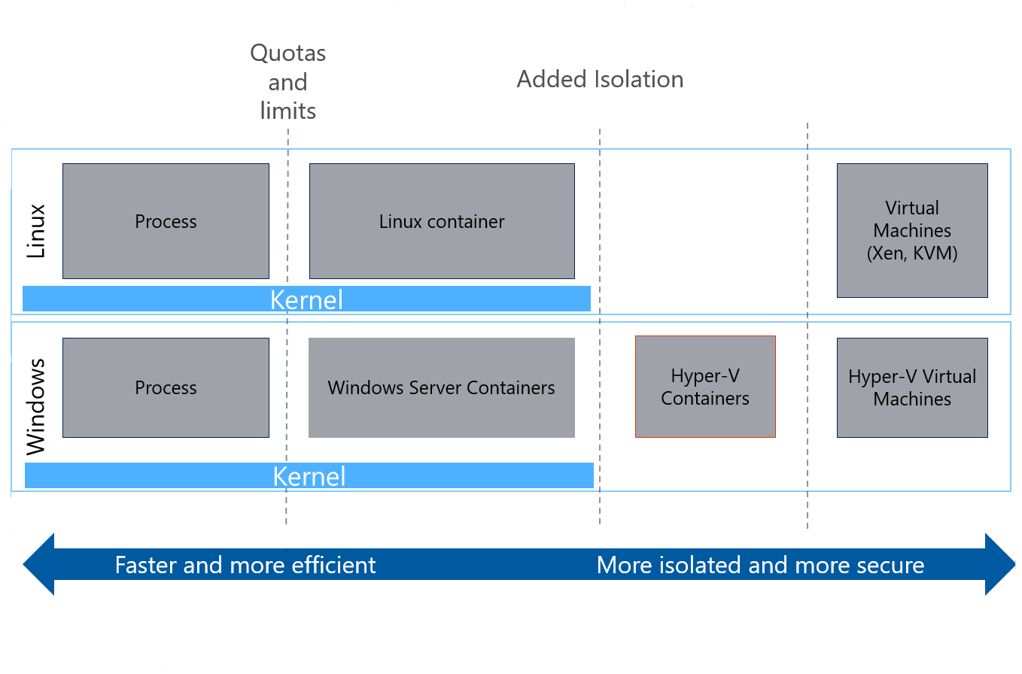
Virtualization and Isolation Levels

Slide 10
Why Containers?
Mitigate “noisy neighbors”
Lift and shift of existing container images
IIS lift and shift (Windows)
Portability & agility

Slide 11
Best Practices
Use resource constraints
  Limits noisy neighbors, especially when mixing and matching containers
Use placement constraints
  Two containers with heavy interaction are better placed on the same node
Health & Load reporting watchdog
  Applicable to single-tenant and non-hostile multi-tenant scenarios

Slide 12
Best Practices: Deployment
Deployment just like any other Service Fabric app
Use environment variables to communicate between containers
Use resource constraints
  Limits noisy neighbors, especially when mixing and matching containers

Slide 13
Best Practices: Performance & Monitoring
Use placement constraints
  Two containers with heavy interaction are better placed on the same node
Health & load reporting watchdog
  Applicable to single-tenant and non-hostile multi-tenant scenarios

Slide 14
Best Practices: Security & Secrets
Front-ends & back-ends on separate nodes
  Always good to do for more security
Use a private repository for IP sensitive images
Encrypt credentials for accessing private registry
  Manage secrets by using Invoke-EncryptText

Slide 15
Demos
Cluster running Windows containers
Code behind resolving containers
Show placement constraints @ work
Show resource governance @ work

Slide 16
Crystal ball says…
Preview of Windows containers support coming soon
Better diagnostics
Jenkins plugin and docs
Reliable collections on Java/C# for Linux
Resource governance & constraints on service fabric apps/services

Slide 17
Resources
Tracing C# apps
Tracing Java apps
More on containers

